Slide 1

Project on
HOUSING PRICE
PREDICTION
by
Balu Gumidelli

Slide 2
SUMMARY:
House prices increase every year, so there is a need for a system to predict house prices in the future. House price prediction can help the developer determine the selling price of a house and can help the customer to arrange the right time to purchase a house. There are three factors that influence the price of a house which include physical conditions, concept and location.

Slide 3
Contents:
Introduction
Problem Statement
What is Housing Price Prediction ?
Importance of Housing Price Prediction
Exploratory Data Analysis
Visualizations
Data Cleaning
Model Building
Saving the Model
Conclusion

Slide 4
Introduction
The aim of this study is basically to deal with House Prices.
Our model can be used by both house sellers and house buyers.
In this presentation we will be looking at the analysis made on the Housing Price Prediction and a machine learning model which is proposed to predict the house price.

Slide 5
PROBLEM STATEMENT
A US-based housing company named Surprise Housing has decided to enter the Australian market. The company uses data analytics to purchase houses at a price below their actual values and flip them at a higher price. For the same purpose, the company has collected a data set from the sale of houses in Australia. The data is provided in the CSV file below.
The company is looking at prospective properties to buy houses to enter the market. You are required to build a model using Machine Learning in order to predict the actual value of the prospective properties and decide whether to invest in them or not. For this company wants to know:
• Which variables are important to predict the price of variable?
• How do these variables describe the price of the house?

Slide 6

What is HOUSING PRICE POREDICTION?
House Price prediction, is important to drive Real Estate efficiency.
This helps people to know house prices who plans to buy a house. As earlier, House prices were determined by calculating the acquiring and selling price in a locality. Therefore, the House Price prediction model is very essential in filling the information gap and improve Real Estate efficiency. With this model, we would be able to better predict the prices.

Slide 7

Importance of Housing Price Prediction:
House Price prediction, is important to drive Real Estate efficiency. As earlier, House prices were determined by calculating the acquiring and selling price in a locality. Therefore, the House Price prediction model is very essential in filling the information gap and improve Real Estate efficiency.

Slide 8
Exploratory Data Analysis:
After importing the Test and Train data sets, I’ve checked the shape, value counts, info and null values in the data sets.
Our dataset has more null values for some columns. So, I’ve dropped the columns with more than 80% of null values and imputation technique was used to fill other columns’ null values.
Feature extraction has done for all the year columns by converting them into their respective ages.
Next, data is visualised for numerical and categorical data by separating them.

Slide 9
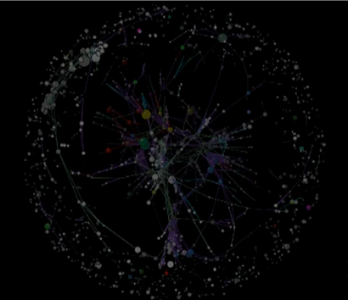
VISUALIZATIONS

Slide 10
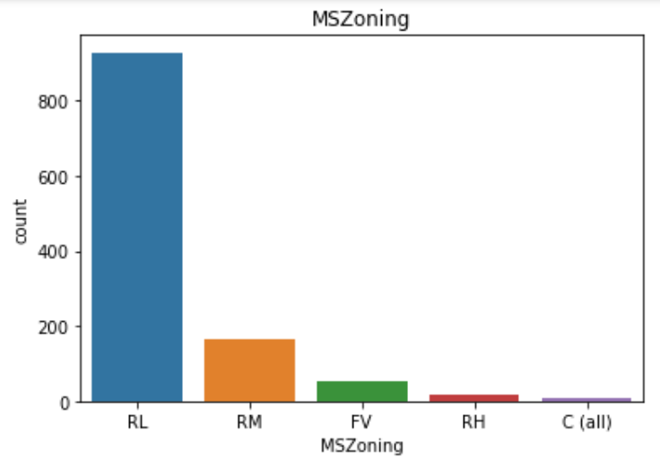
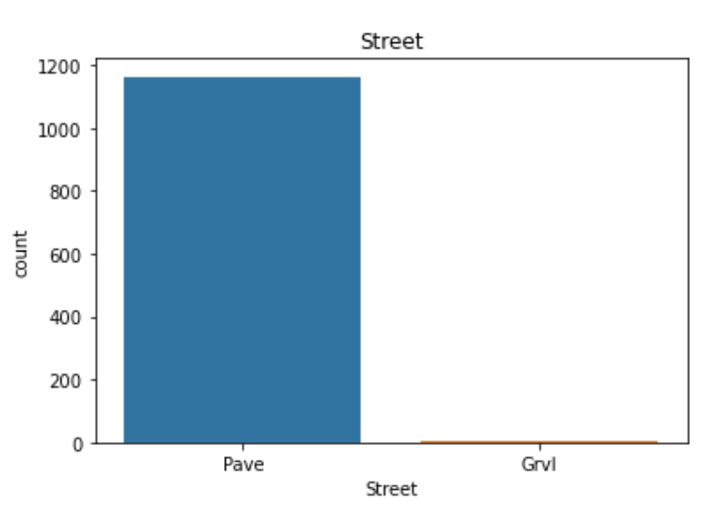
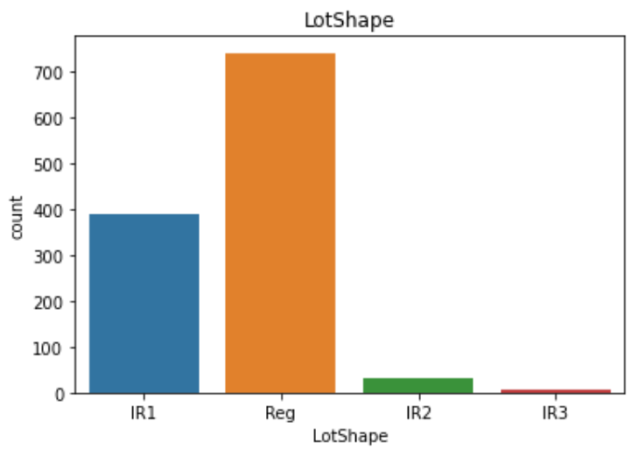
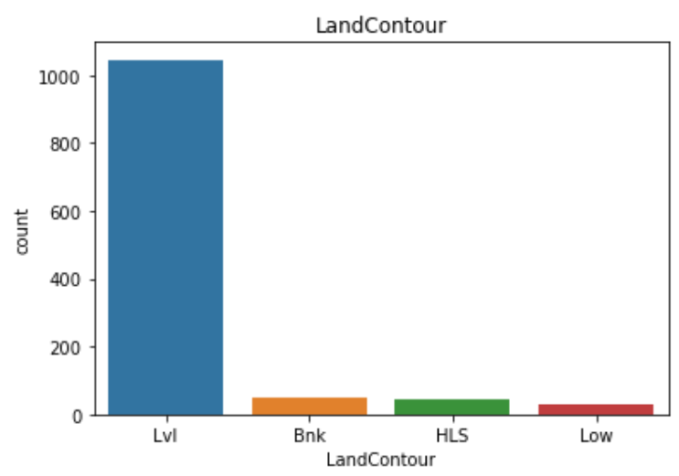

Slide 11
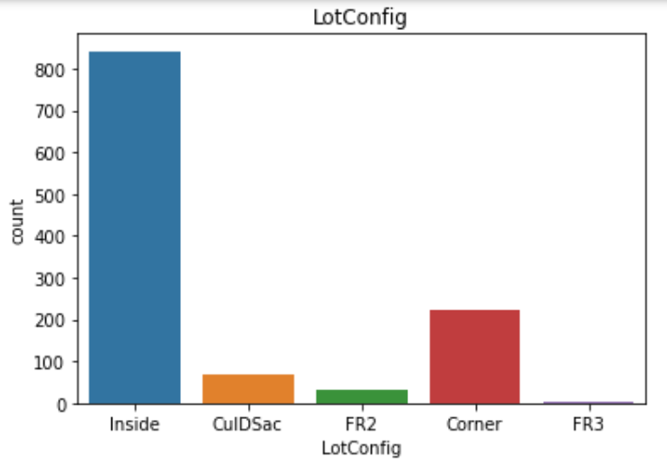
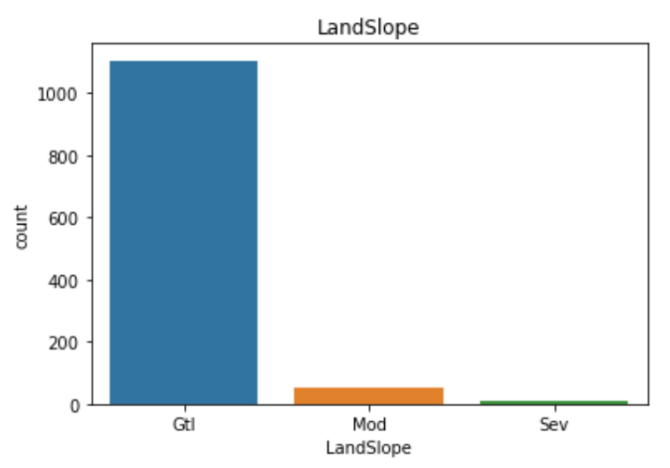
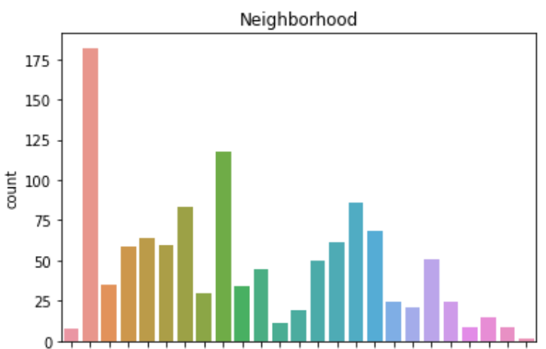
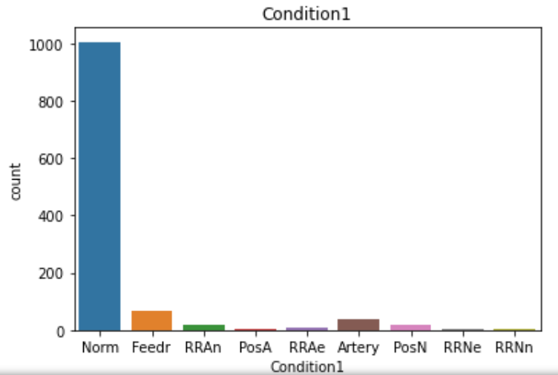

Slide 12
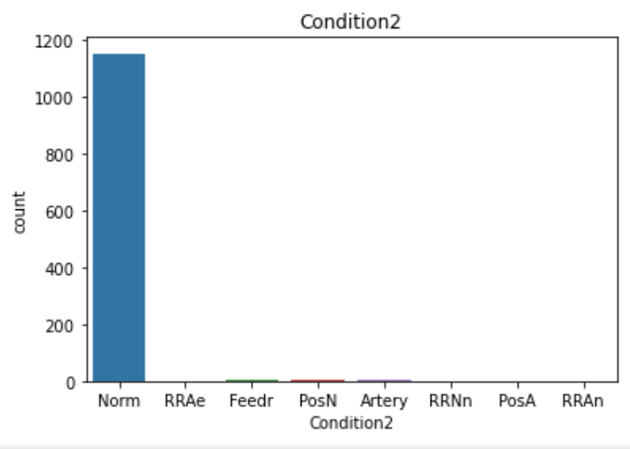
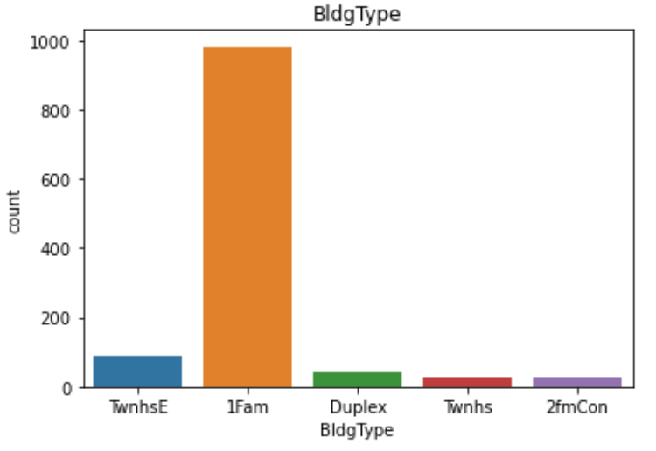
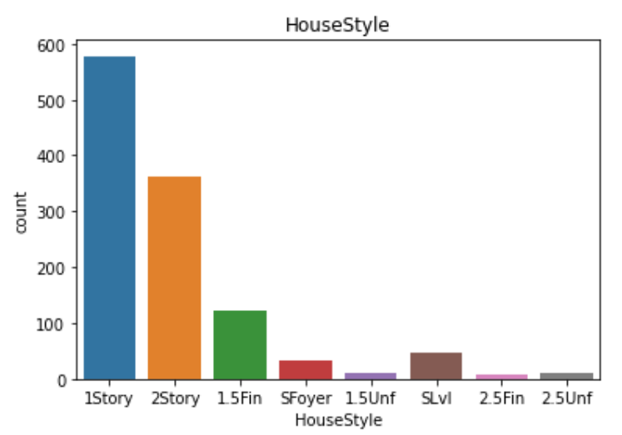
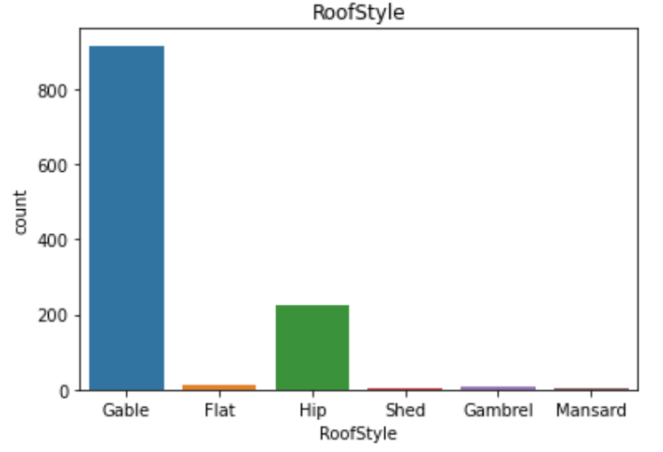

Slide 13
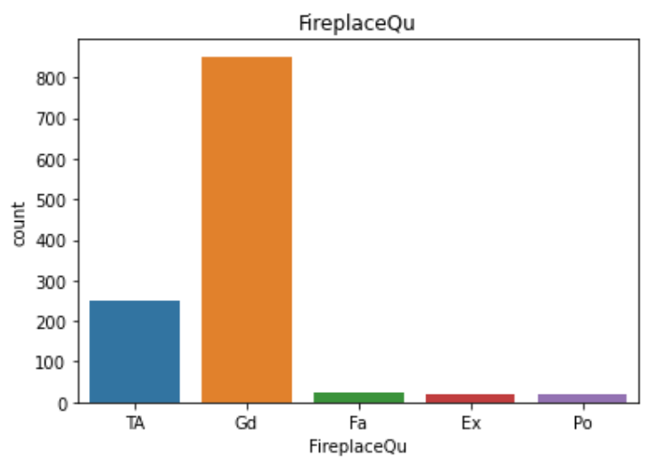
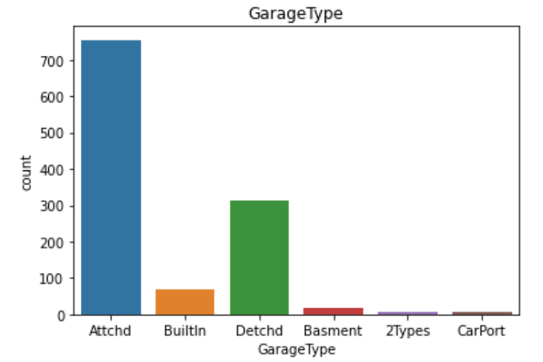
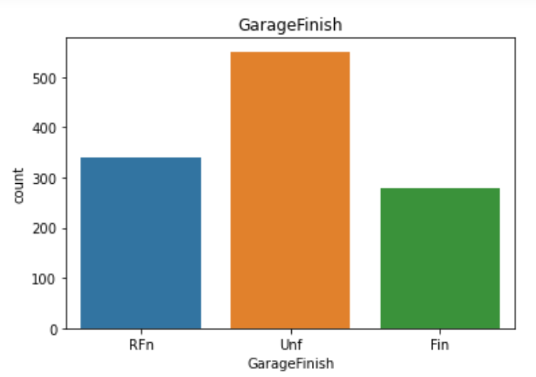
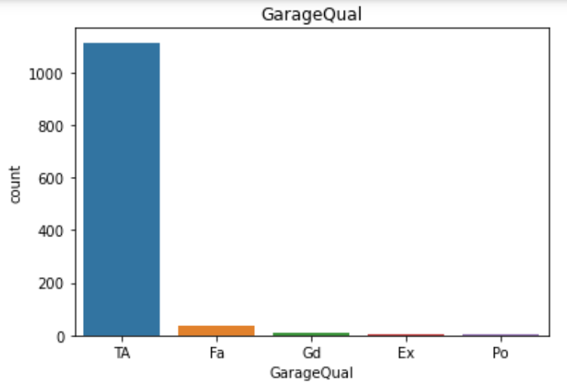
.

Slide 14
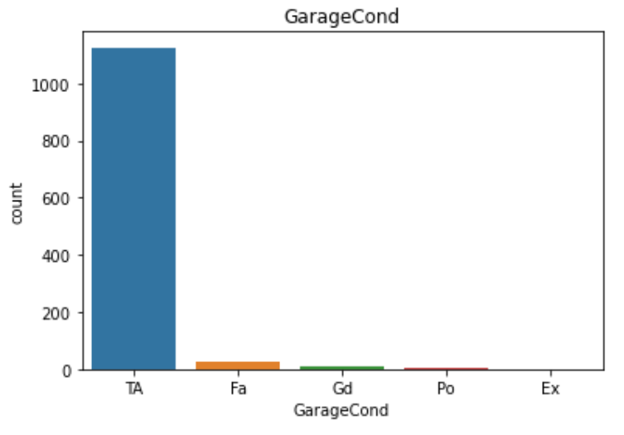

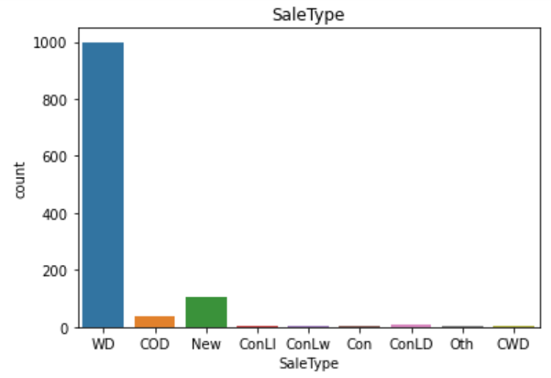
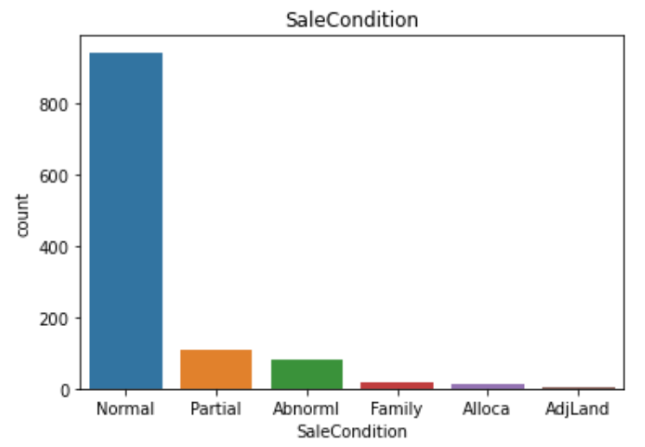

Slide 15
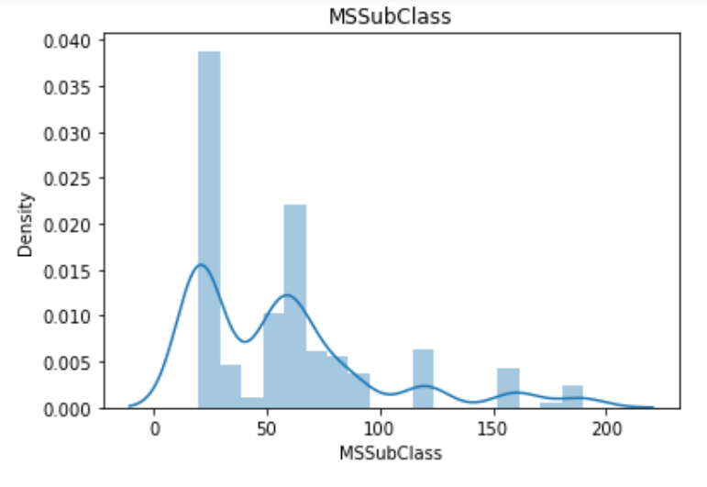
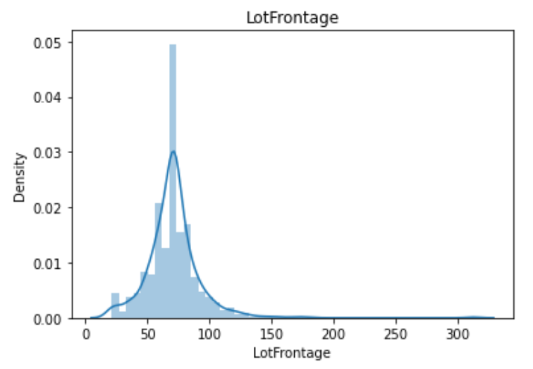
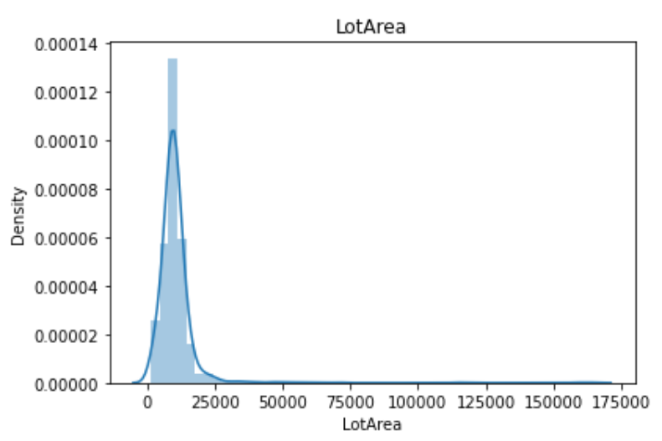
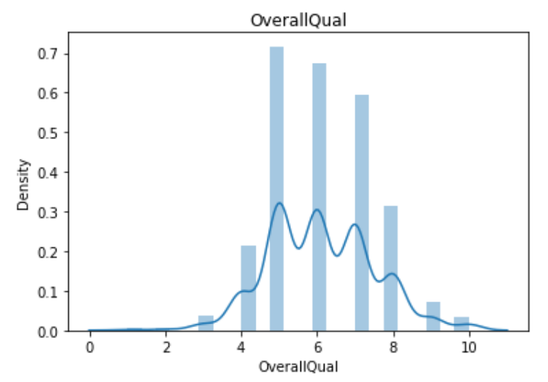

Slide 16
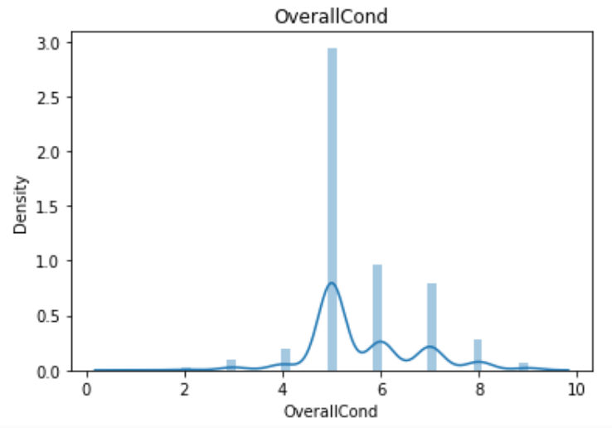
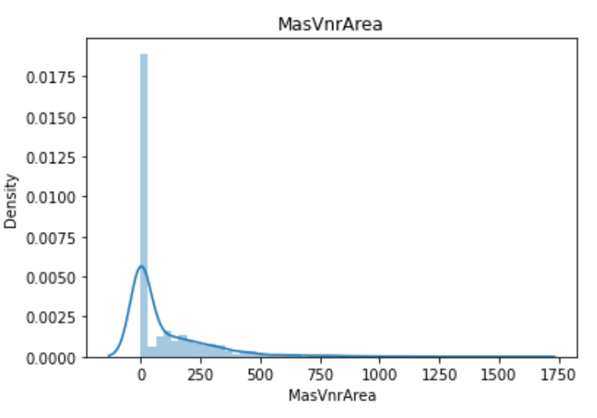
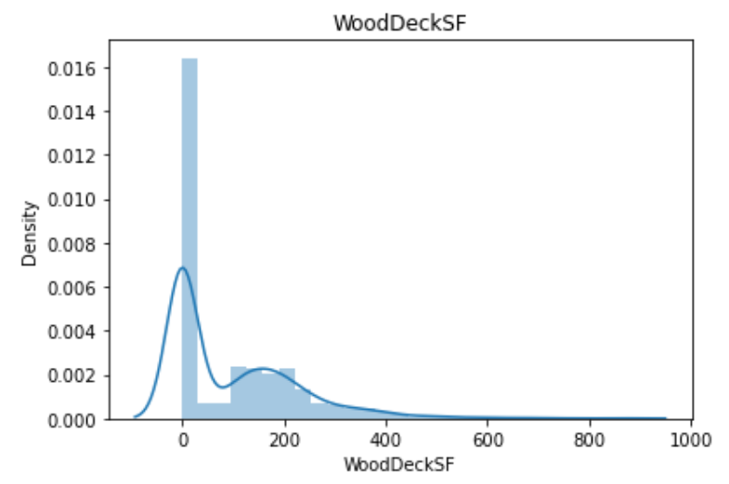
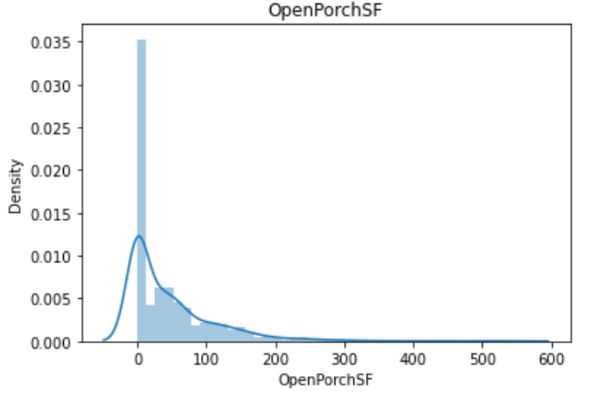

Slide 17
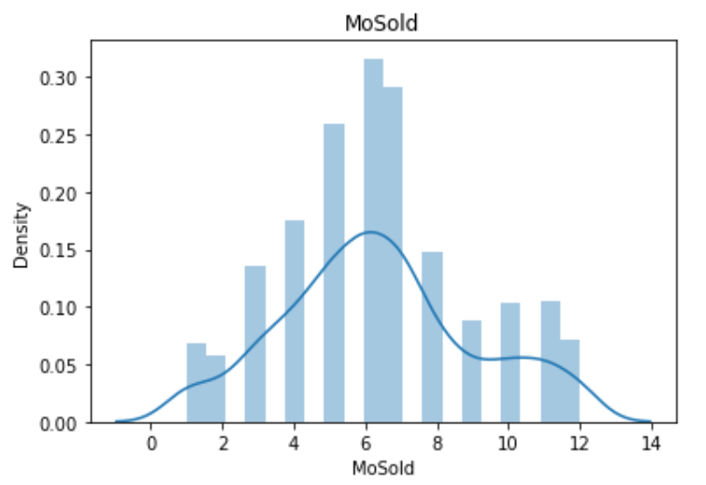
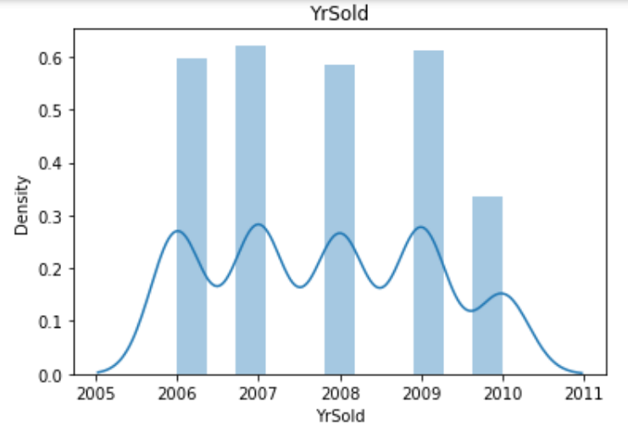
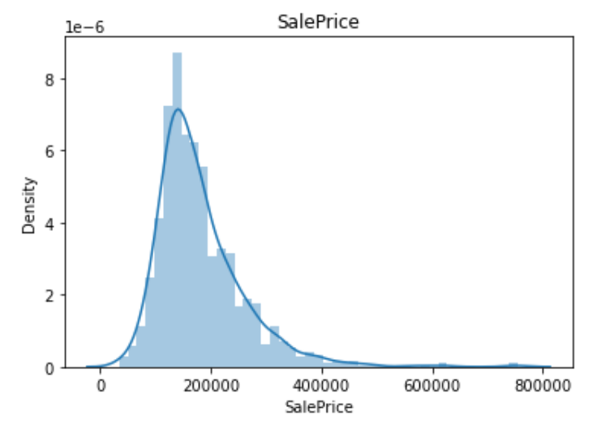
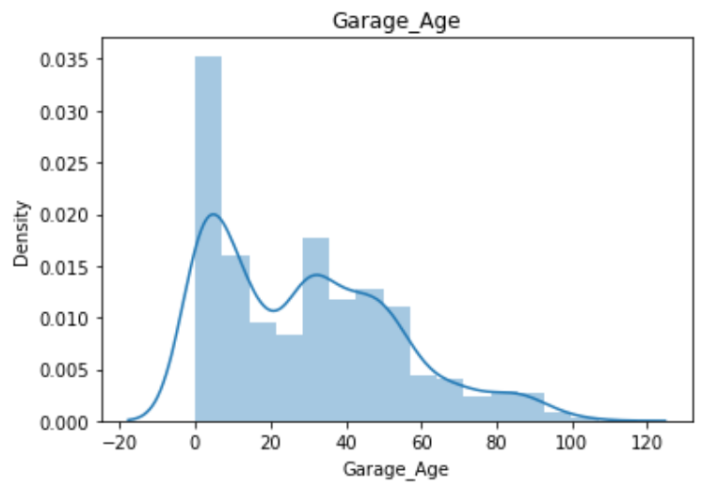

Slide 18
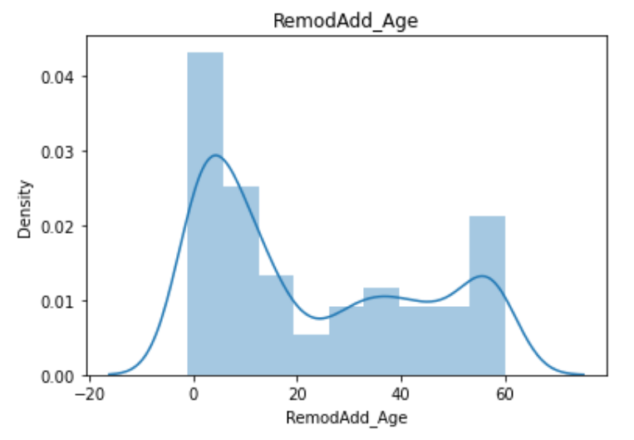
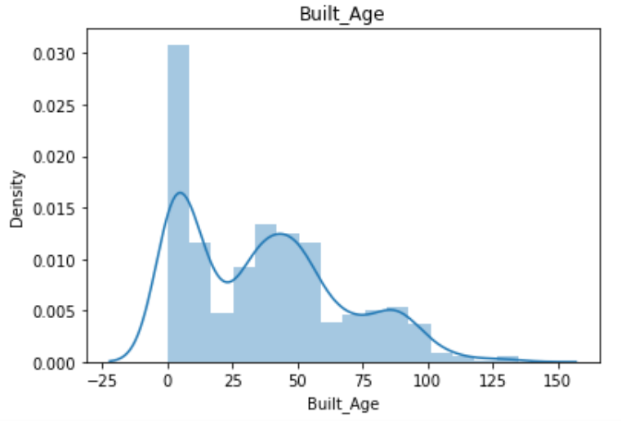
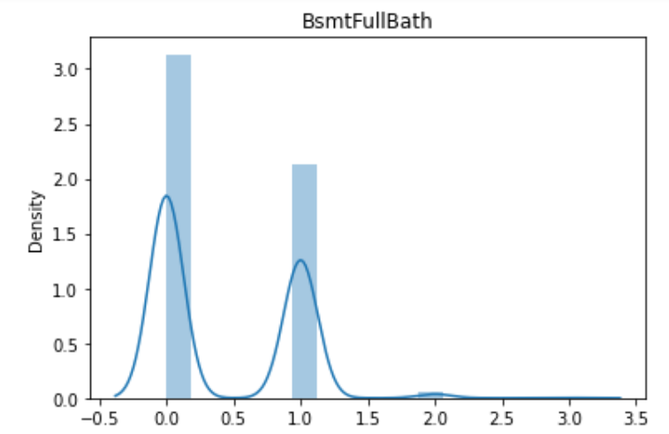
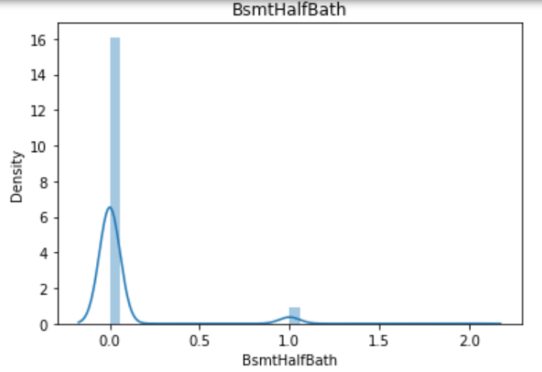

Slide 19
Data Cleaning
Our dataset contains null values and outliers. Imputation techniques were used for treating null values.
Skewness has identified using distribution plots and skewness has removed using power transformer.
Categorical columns were encoded using Ordinal Encoder.
The correlation was visualised using bar plot.
Next the data was scaled using standard scaler and dropped the columns with high VIF values.
After the above steps the model building process is done in further steps.

Slide 20
Model Building:
SalePrice is our target variable and it contains continuous data.
We have used regression algorithms to solve the problem because it contains continuous data.
We have used the following algorithms;
Random Forest Regressor
Decision Tree Regressor
Extra Trees Regressor
Gradient Boosting Regressor
Among all the algorithms Gradient Boosting Regressor performed well with 90% accuracy

Slide 21
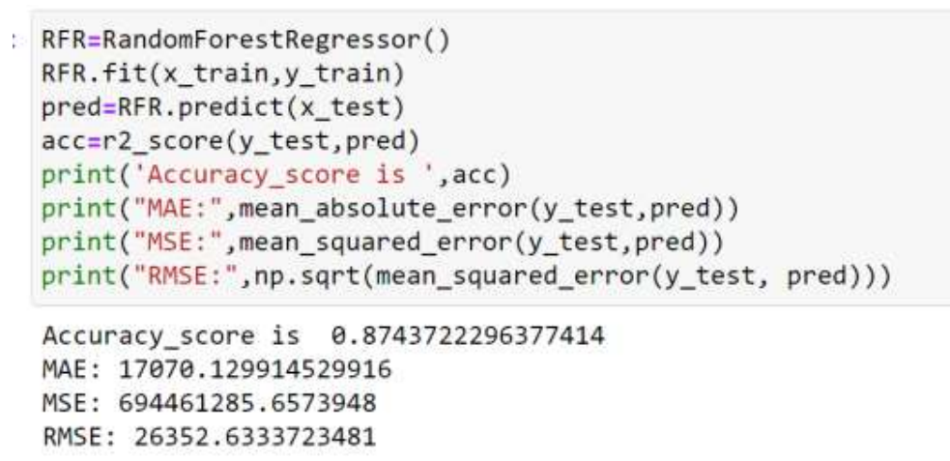
Random Forest Regressor:
Random Forest Regressor was performed good with 87% accuracy but let’s check with other algorithms.

Slide 22
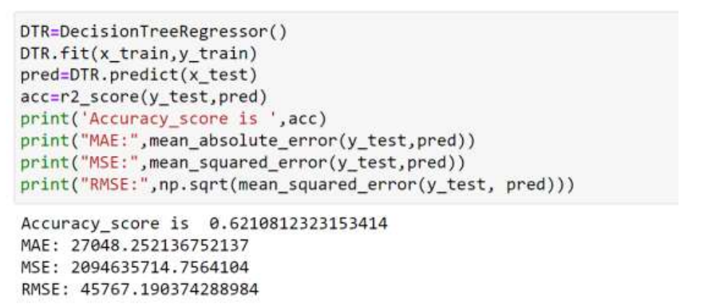
Decision Tree Regressor:
Decision Tree Regressor Accuracy Score is not so good, so let’s see the other algorithms.

Slide 23
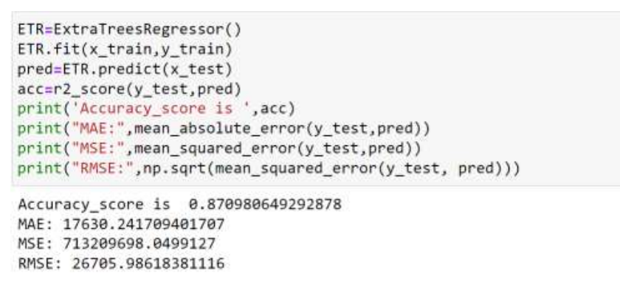
Extra Trees Regressor:
Extra Trees Regressor is also performing good with 87% accuracy score, so let’s check with other algorithms.

Slide 24
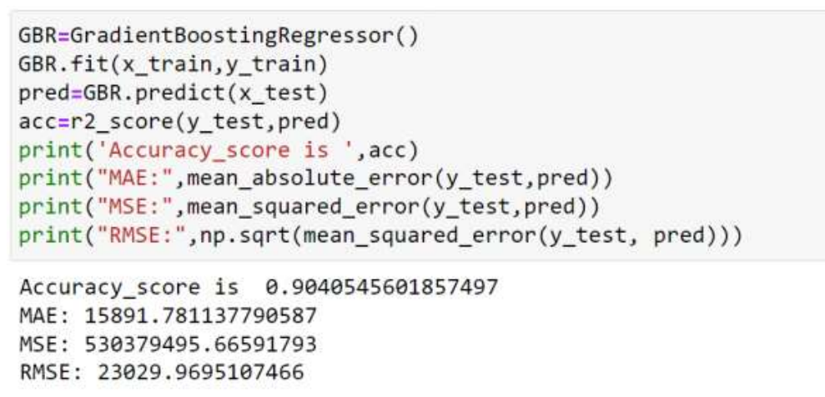
Gradient Boosting Regressor:
Gradient Boosting Regressor is performing great with 90% accuracy score. So, let’s proceed with this algorithm

Slide 25
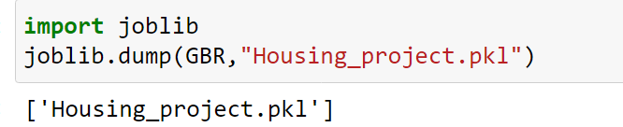
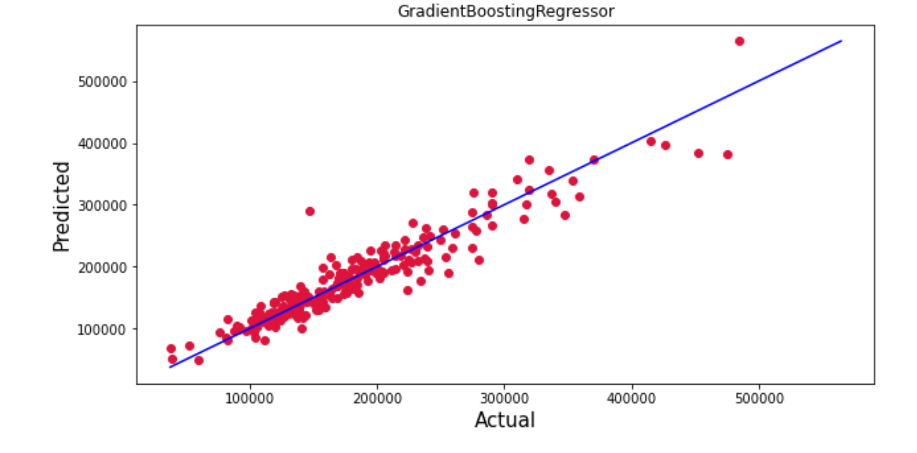
Saving the model:

Slide 26
Conclusion:
We have discussed about the EDA and data cleaning process and used machine learning algorithms for predicting house prices.
So far we’ve got 90% accuracy score for our model.
We can conclude that this model is useful for house buyers and sellers to understand the prices of the houses and can predict future prices.
By this we can conclude that the application of machine learning in property research is still at an early stage but we have achieved a good model.

Slide 27
THANK YOU

